Slide 1
Approaches to User Experience Design (Look and Ask) Session #02
Course : GAME6012/ User Experiences
Effective Period : September 2017

Slide 2
These slides have been adapted from: Julie A. Kientz (2014). User Experience Design, University of Washington.
Acknowledgement

Slide 3
Learning Objectives

Slide 4
4 Approaches that can help us start
Look at what users really do
Ask users to help
Learn from the fact you gathered
Try it yourself

Slide 5
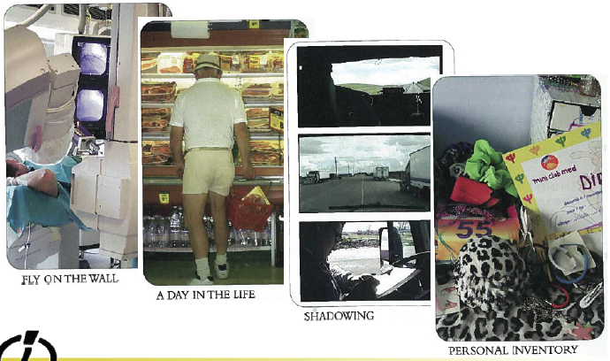
LOOK at what users really do

Slide 6
Observing People
What do we "see"?
Opportunities for new designs
Breakdowns
Workarounds
Mismatches between what users say and do

Slide 7
LOOK at what users really do
Behavioral Archaelology
Behavioral Mapping
Fly on the Wall
Guided Tours
Personal Inventory
Rapid Ethnography
Shadowing
Social Network Mapping
Still-Photo Survey
Time-Lapse Video

Slide 8
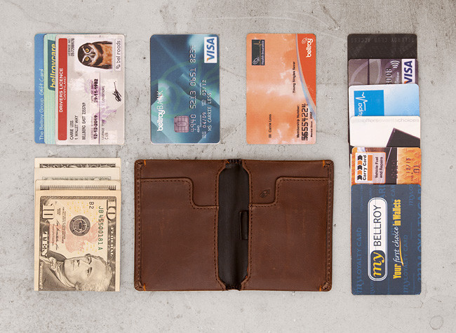
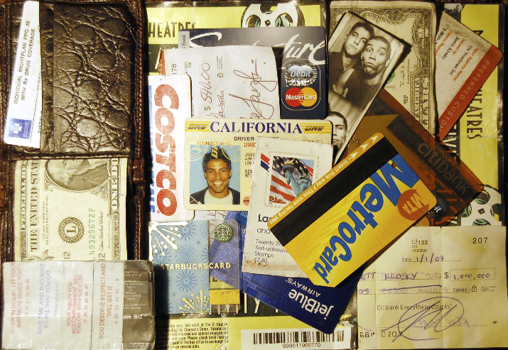
Example
Jofish Kaye, Yahoo Research
To understand people’s personal financial practices, had them empty their wallets and talk through the contents

Slide 9
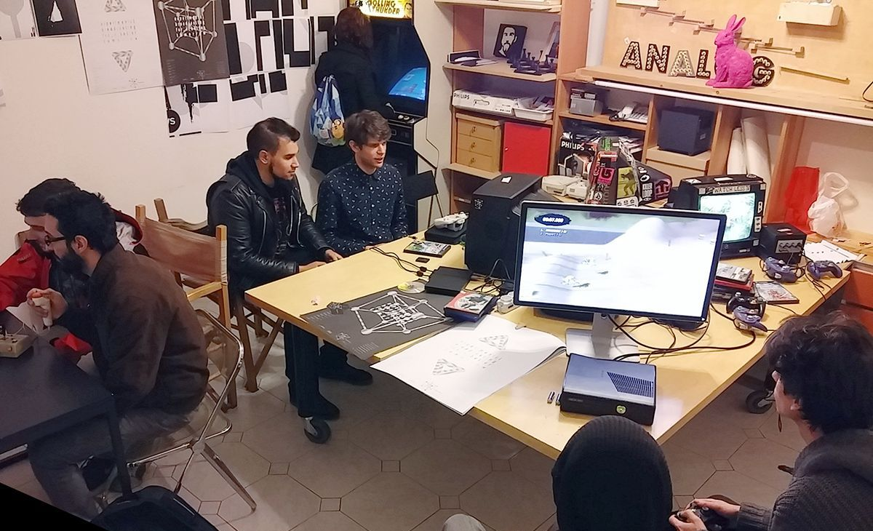
So how to understand our player?
Go and observe

Slide 10

So how to understand our player?
Uses historical data ☺

Slide 11
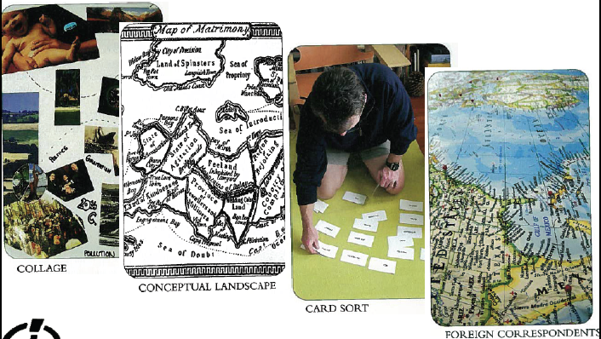
ASK users to help

Slide 12

How to get help
Focus Group Discussion

Slide 13

How to get help
Check out game event

Slide 14
Assignment
Find a game in playstore
Identify the player
Find the player
Ask the player why they like the game
Observe the player

Slide 15
References
Buxton, William. 2007. Sketching user experience. Elsevier
Anderson, Stephen. 2011. Seductive Interaction Design. New Riders.
Faranello, Scott. 2016. Practical UX Design. Packt Publishing

